Slide 1
Module 1: Introduction to Data Science Theory

Slide 2
Module 1: Introduction to Data Science
WHAT IS DATA SCIENCE?
Before you can start learning how to use data science techniques and build machine learning solutions, it might be useful to start by defining what we mean by "data science". In this course, we use the following definition:
Data Science is the exploration and quantitative analysis of all available structured and unstructured data to develop understanding, extract knowledge, and formulate actionable results.
So what does that actually mean?
Click the next topic in the navigation bar at the top of the page to find out.

Slide 3
Module 1: Introduction to Data Science
KEY POINTS
Data science is about using data to make decisions that drive actions.
Data science involves:
Finding data
Acquiring data
Cleaning and transforming data
Understanding relationships in data
Delivering value from data
Predictive analytics is about using past data to predict future values.
Prescriptive analytics is about using those predictions to drive decisions.

Slide 4
Module 2: The data science Process
INTRODUCTION TO THE DATA SCIENCE PROCESS
Data science is not new. In fact, it's been around for many years.
Over that time, various groups of data professionals have defined and documented methodologies that are useful when you need to conduct a data science project. This chapter explores these methodologies and explains the core principles that underlie the data science process.

Slide 5
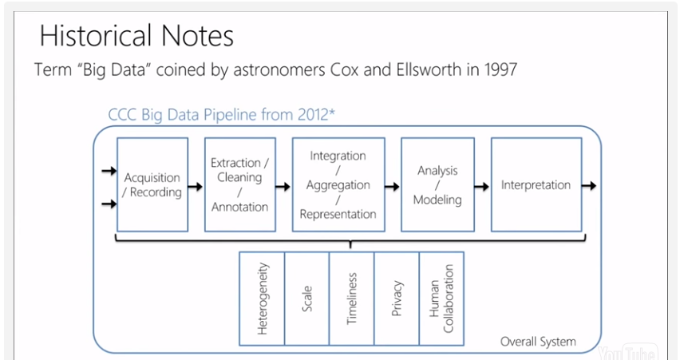
Module 2: Overview of the CCC data science process

Slide 6
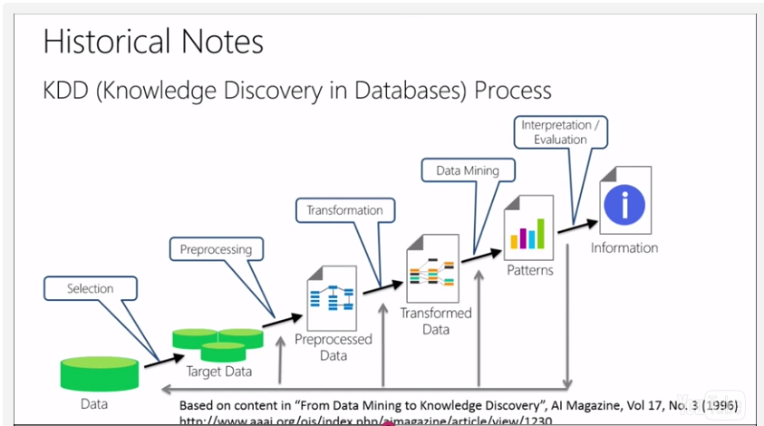
Module 2: Overview of the KDD data science process KDD = Knowledge Discovery Process

Slide 7
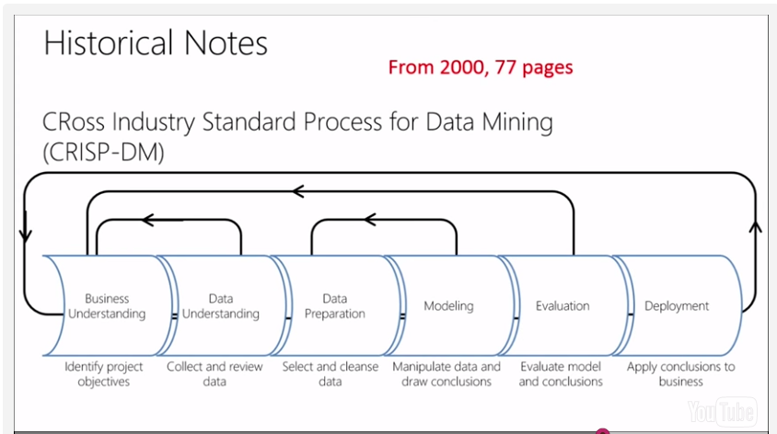
Module 2: Overview of the CRISP-DM data science process CRISP-DM = CRoss Industry Standard Process for Data Mining

Slide 8
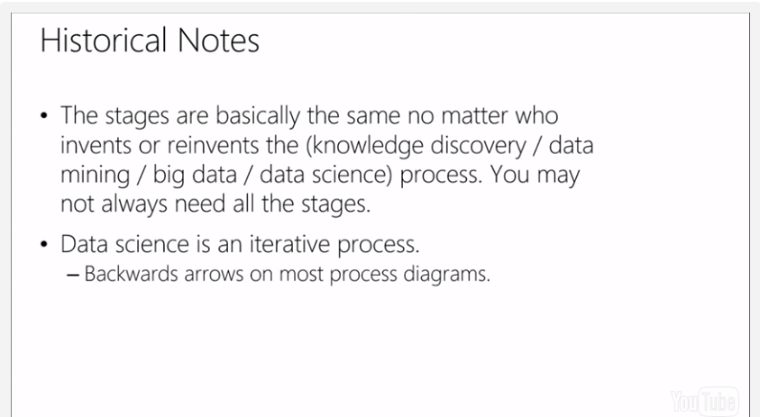
Module 2: Historical Notes

